Slide 1
Internship Project
Customers and Product Sales Data

Slide 2
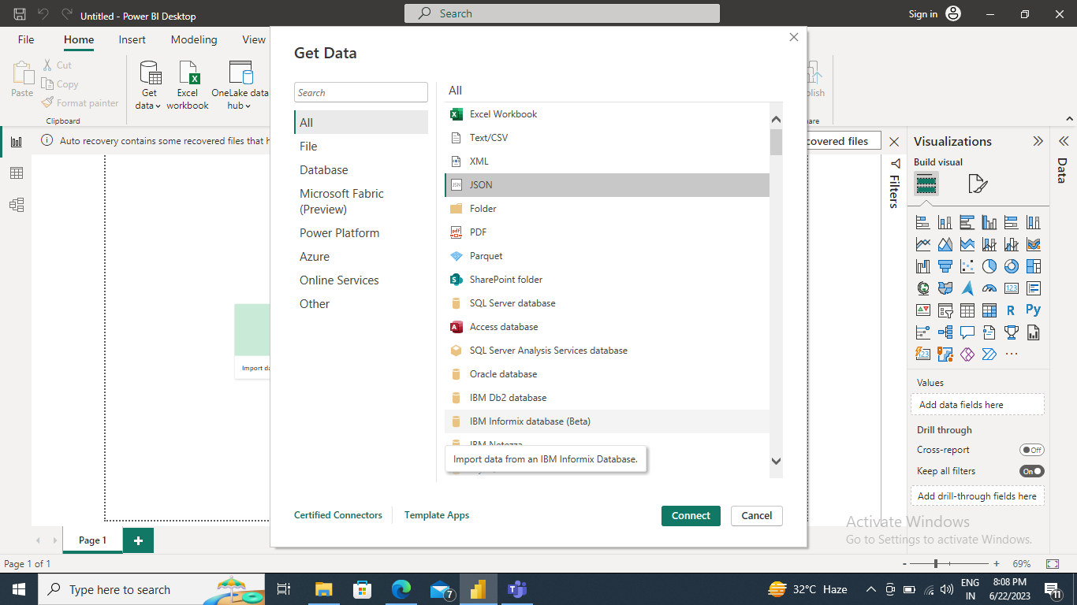
Q1 Import the Data which is in a JSON file into PowerBI ,verify if the data is properly imported or not.

Slide 3
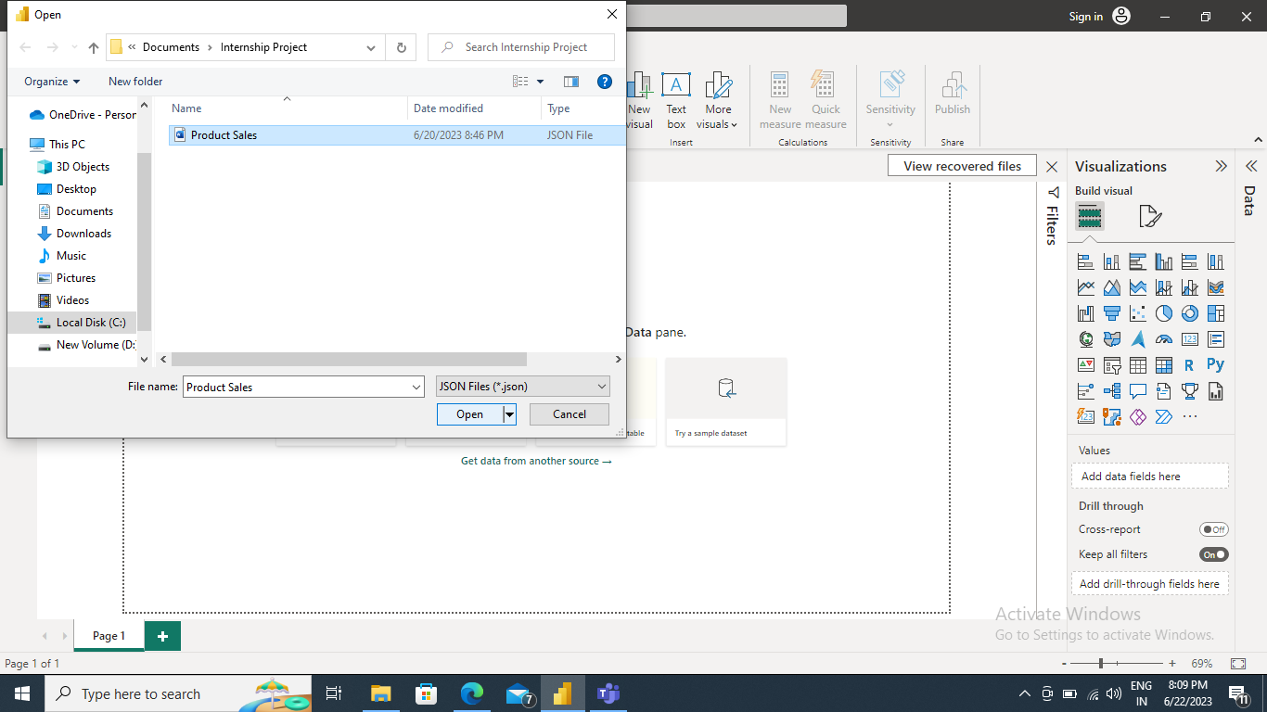

Slide 4
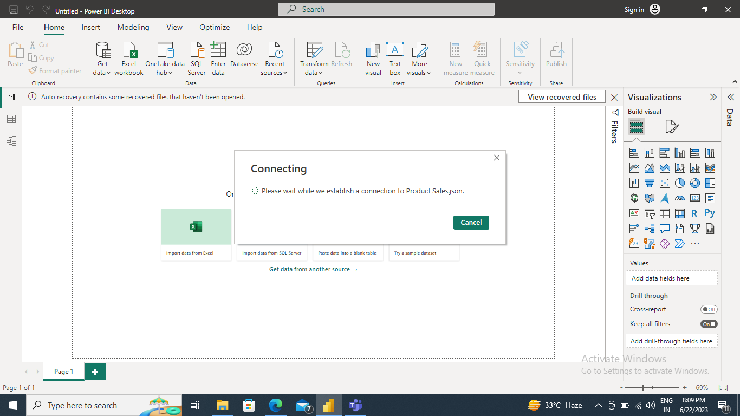

Slide 5
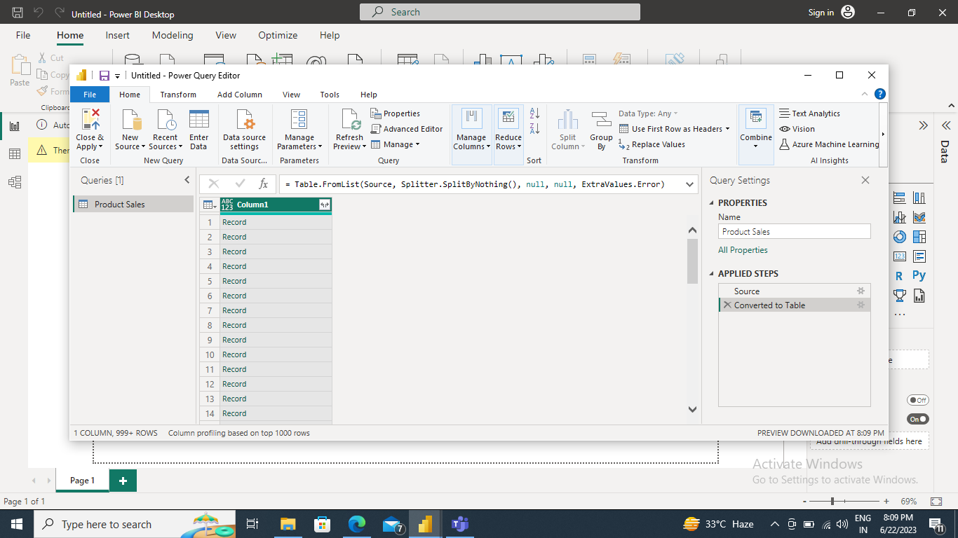

Slide 6
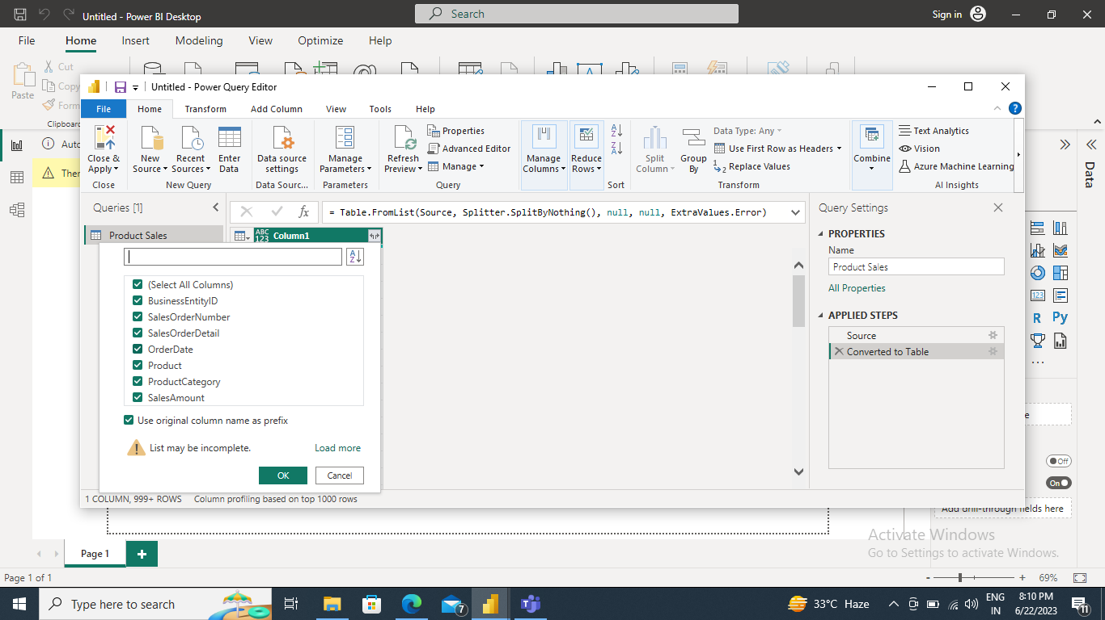

Slide 7
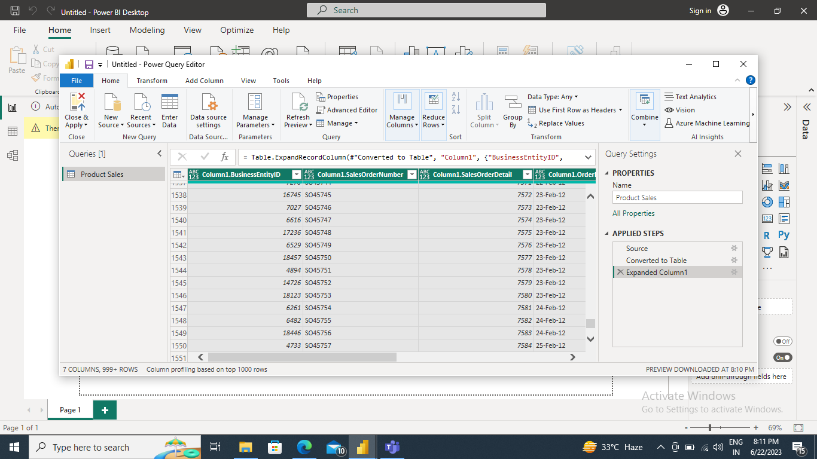

Slide 8
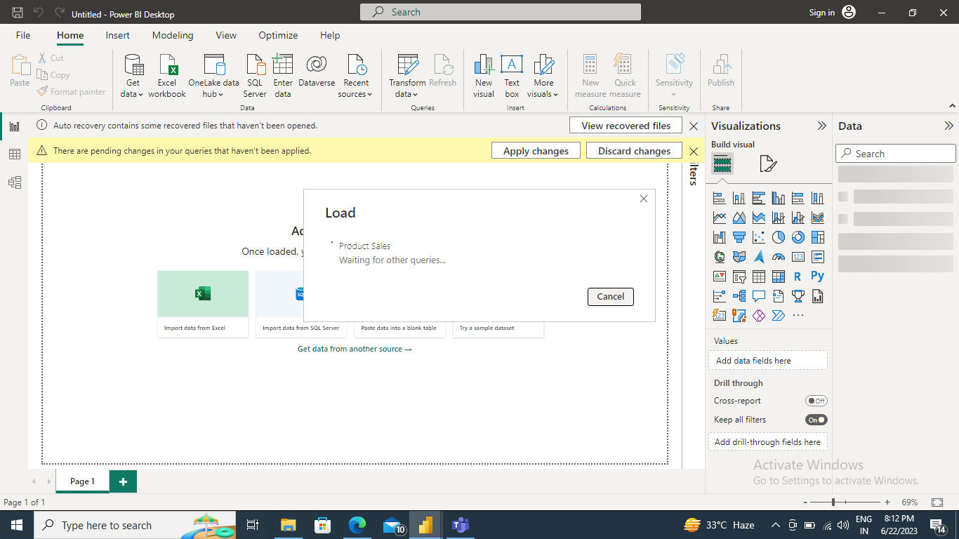

Slide 9
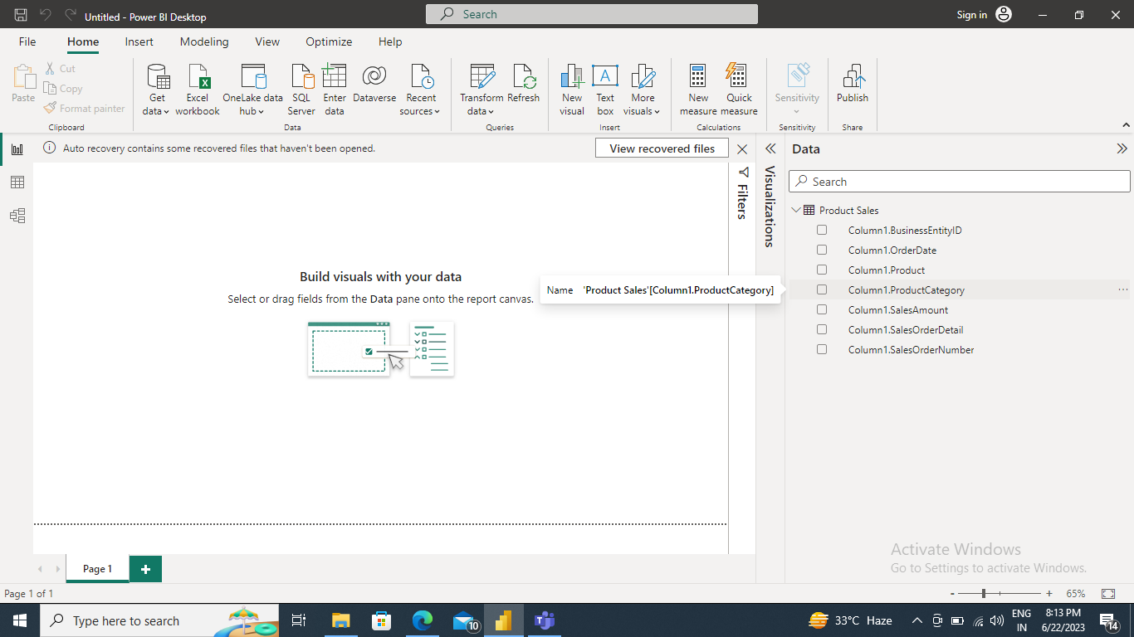

Slide 10
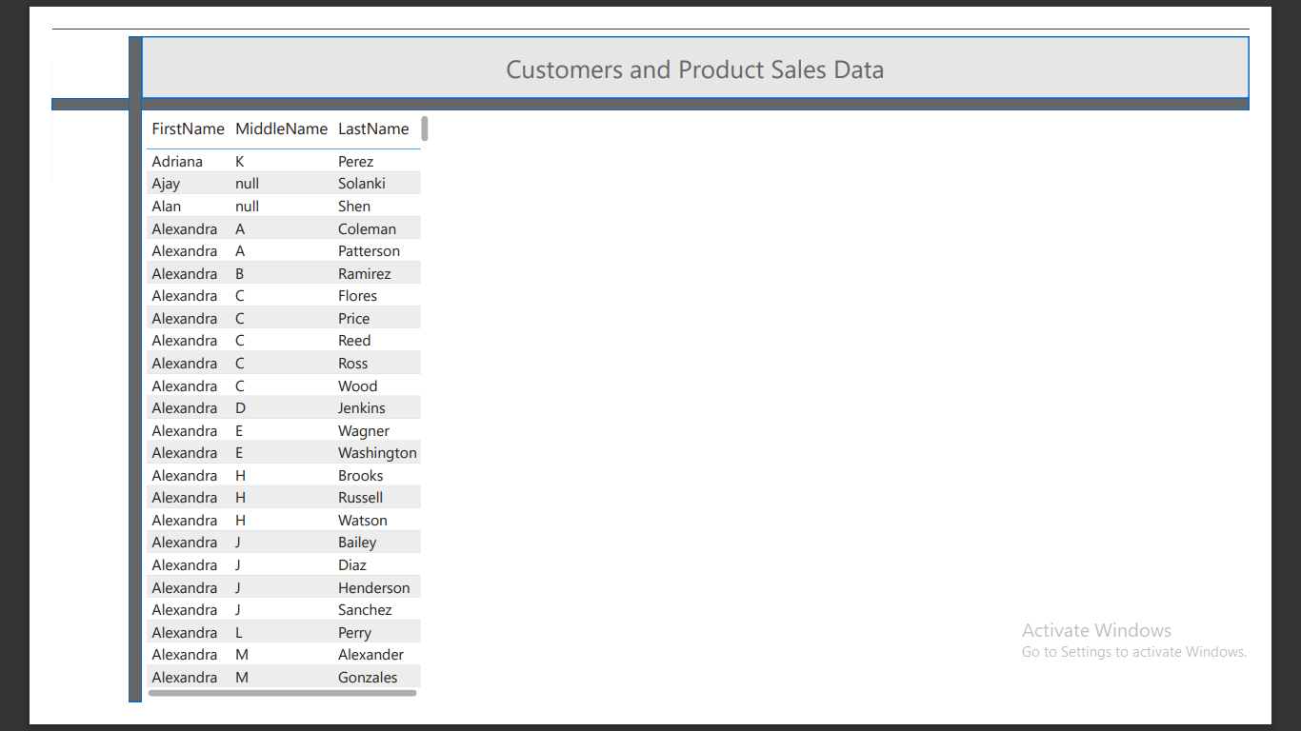
Q2 Perform Data cleaning and other possible operations on data using query editor ,create measures if necessary and use them to visualize the data and make an interactive visualization Q3 Make a Detailed Interactive Dashboard by using visualization tools such as PowerBI and Answer the following questions ➔ Transform customers data so that firstName, MiddleName and LastName are merged into full name.

Slide 11
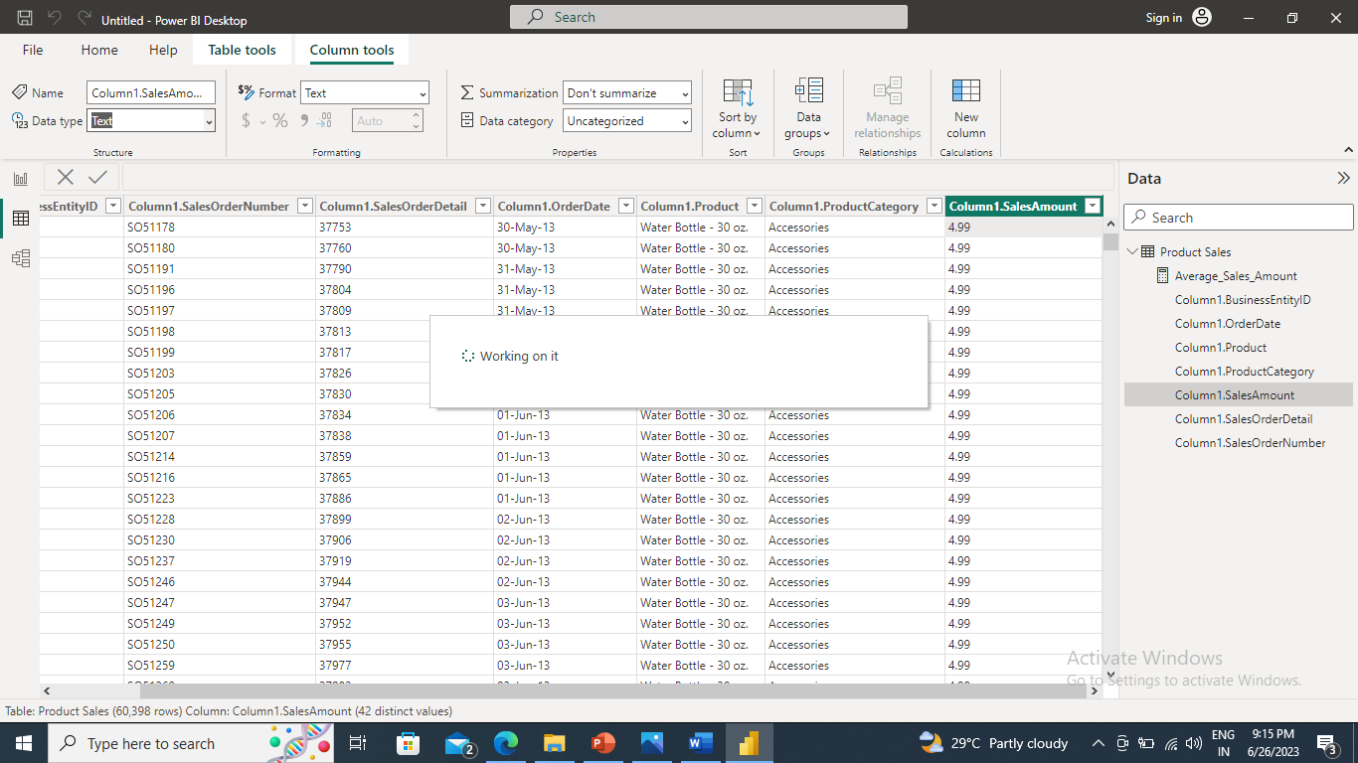
Q2 Perform Data cleaning and other possible operations on data using query editor ,create measures if necessary and use them to visualize the data and make an interactive visualization. (Note: I had to clean data where it has to be converted text into whole number in Data View first to calculate various majors as well)

Slide 12
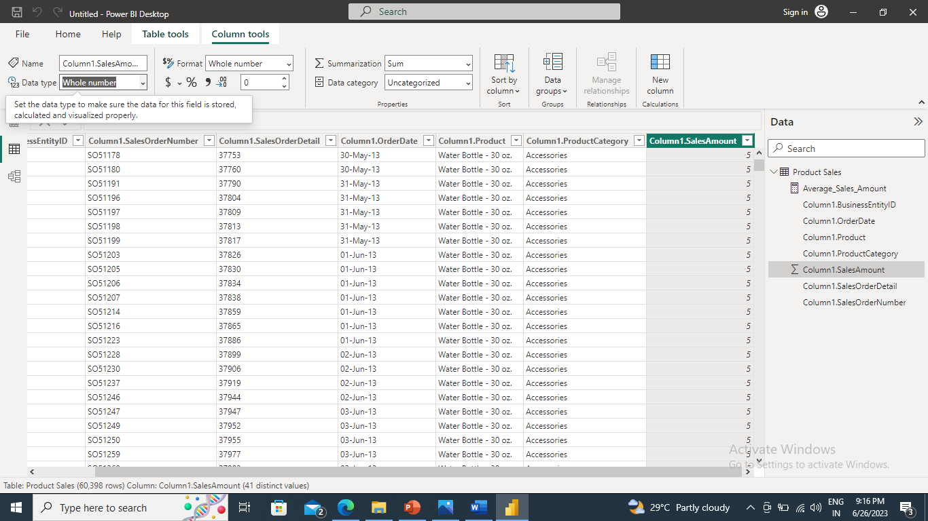

Slide 13
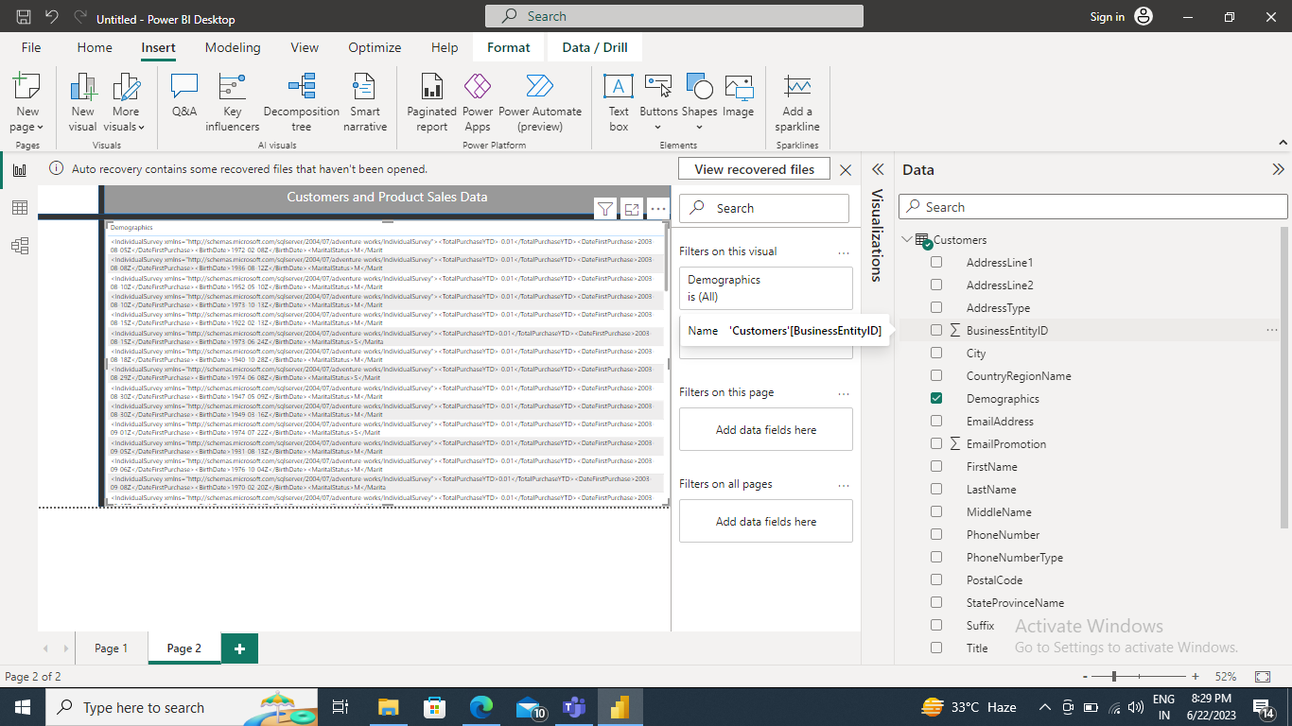
➔ Delete column demographics..

Slide 14
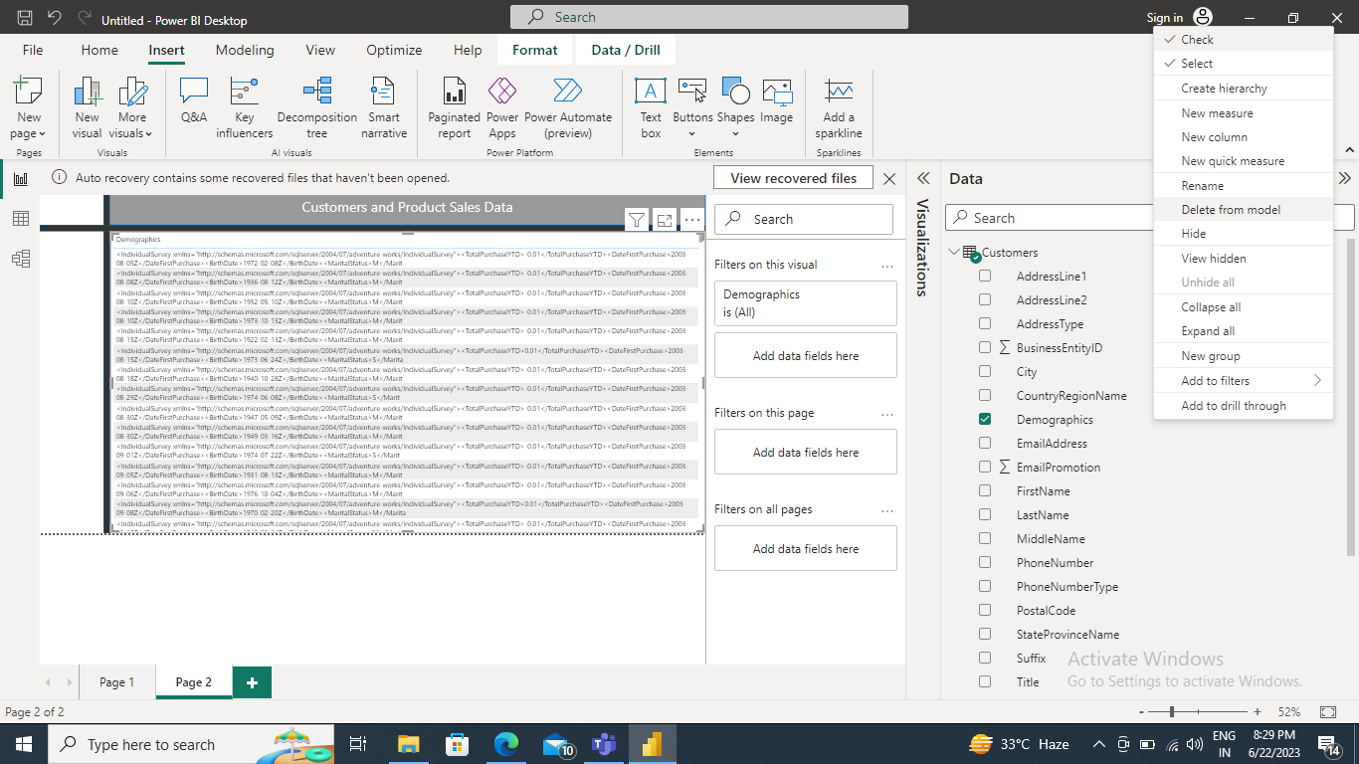

Slide 15
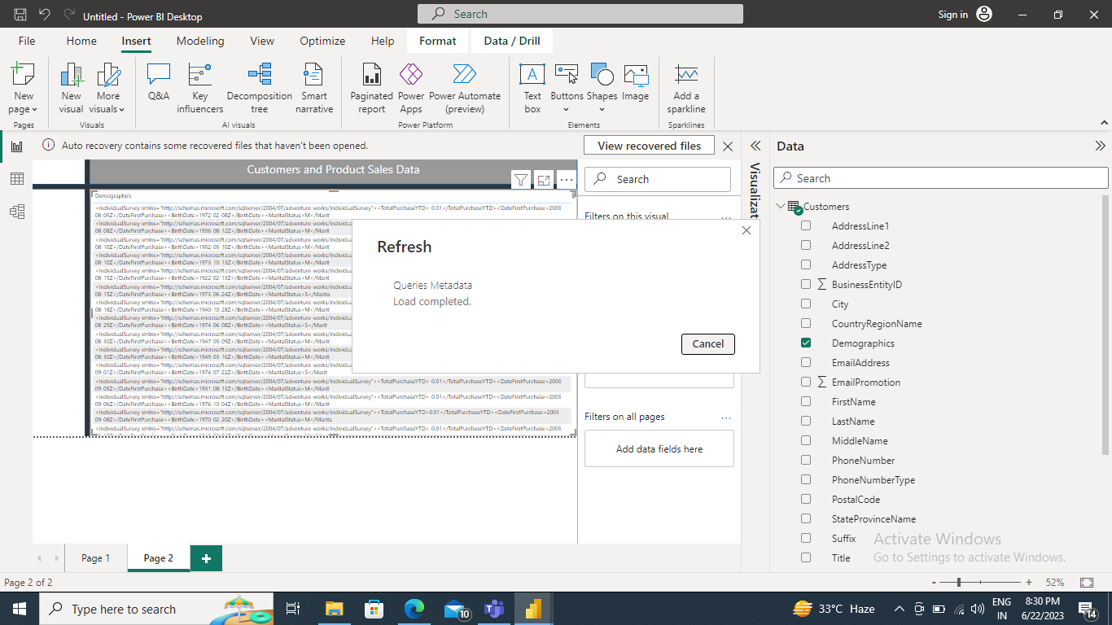

Slide 16
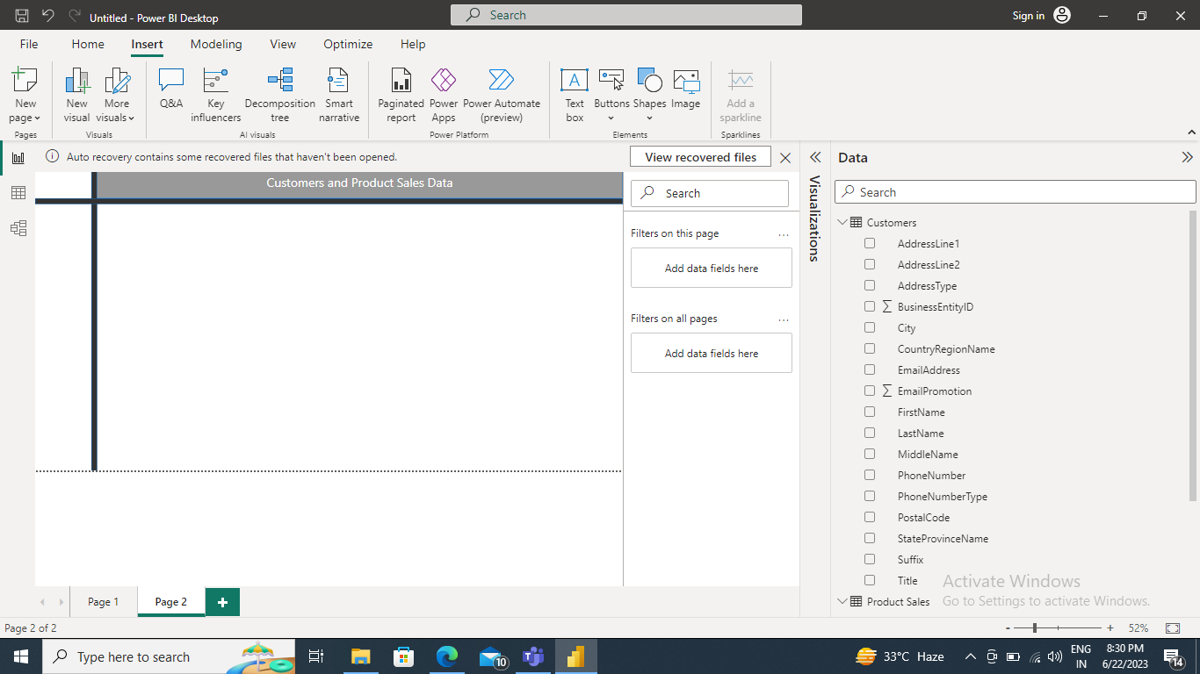

Slide 17
➔ Create measures like Total_Sales_Amount. (for that I had to clean data where it has to be converted text into whole number in Data View first)

Slide 18
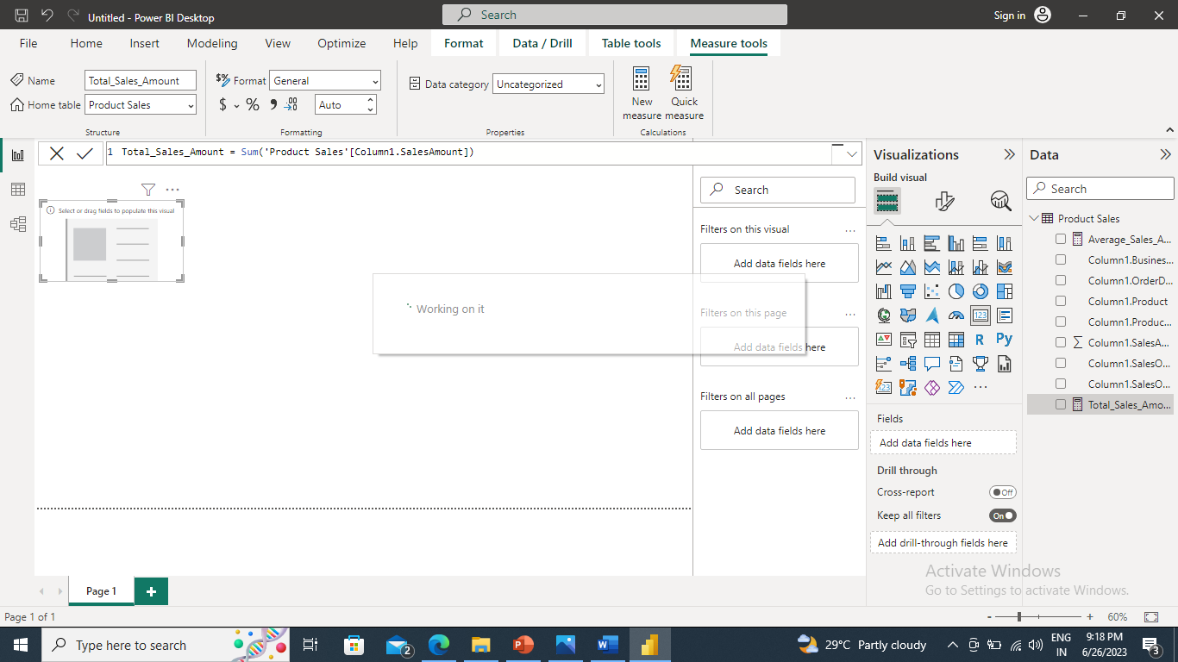

Slide 19
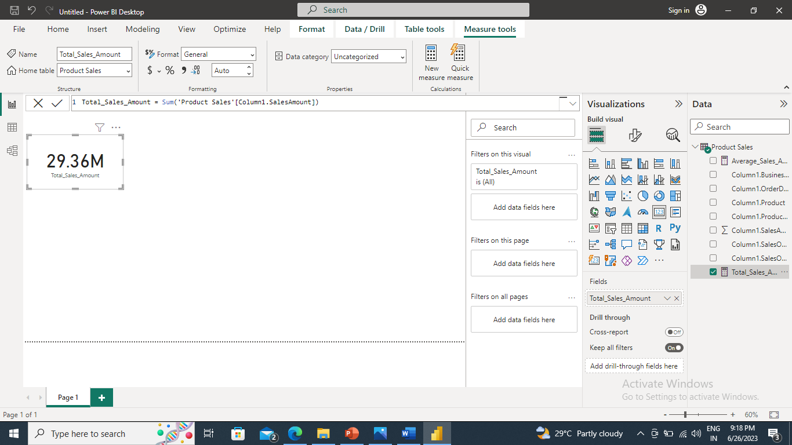

Slide 20
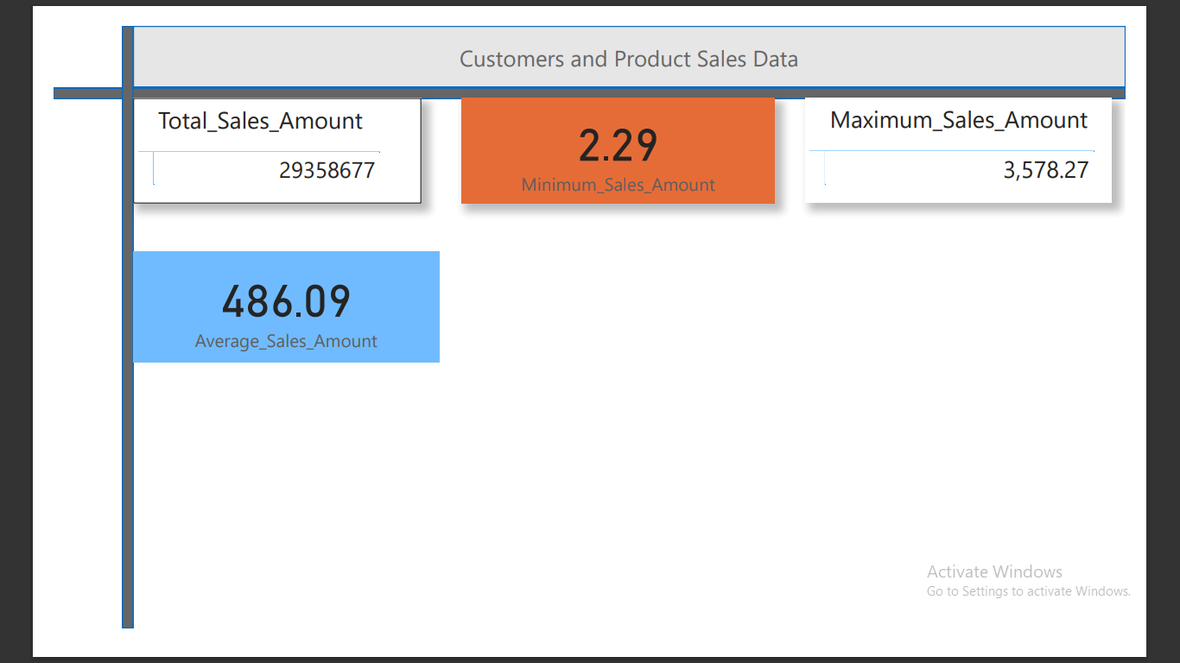
➔ Create a measure like Average,Min,Max TotalSalesAmount.

Slide 21
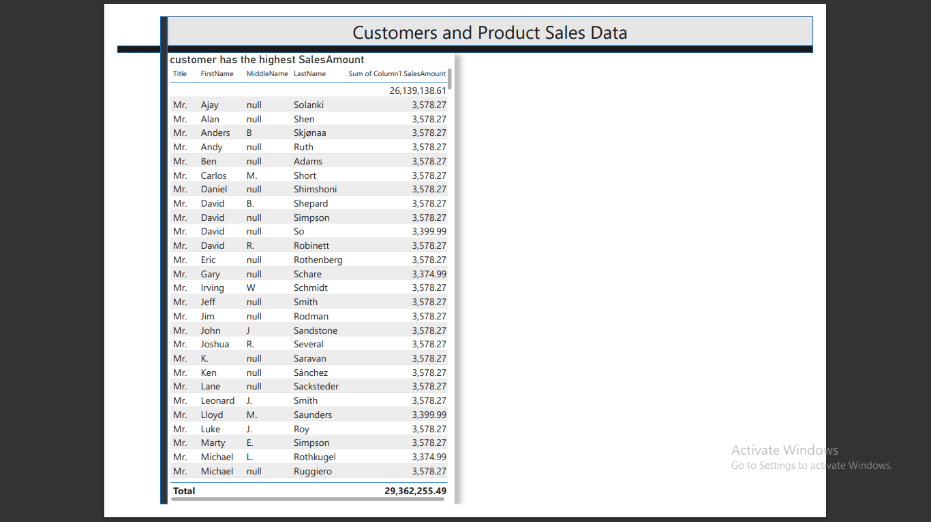
➔ Customer has the highest Sales_Amount

Slide 22
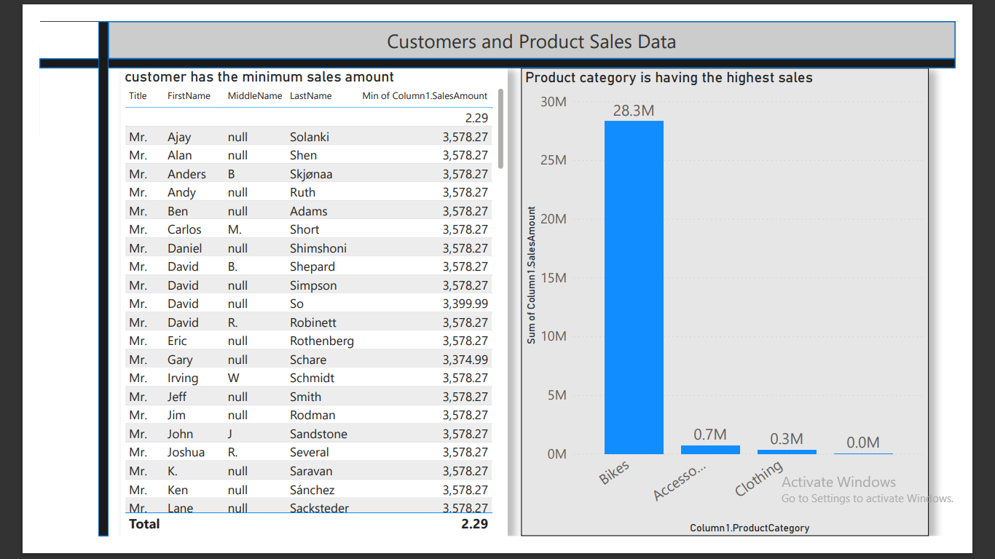
➔ Customer has the minimum sales amount & Product category is having the highest sales

Slide 23
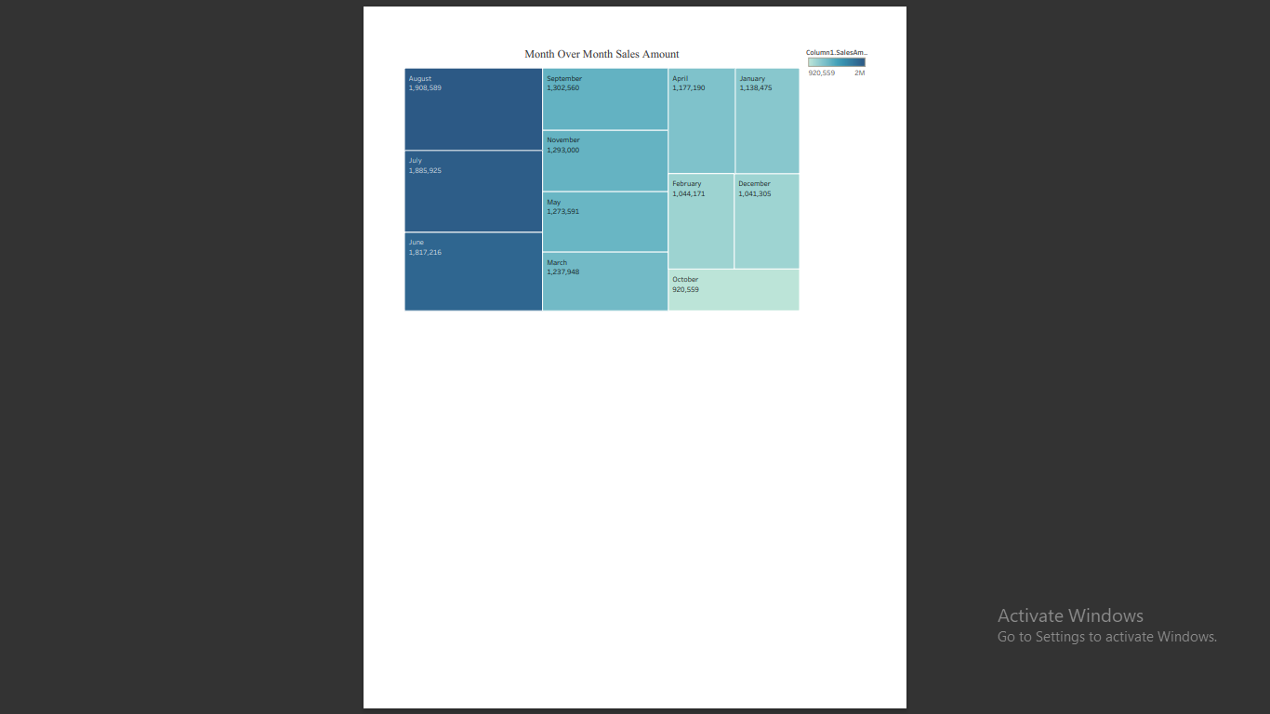
➔ Show month over month Sales Amount.

Slide 24
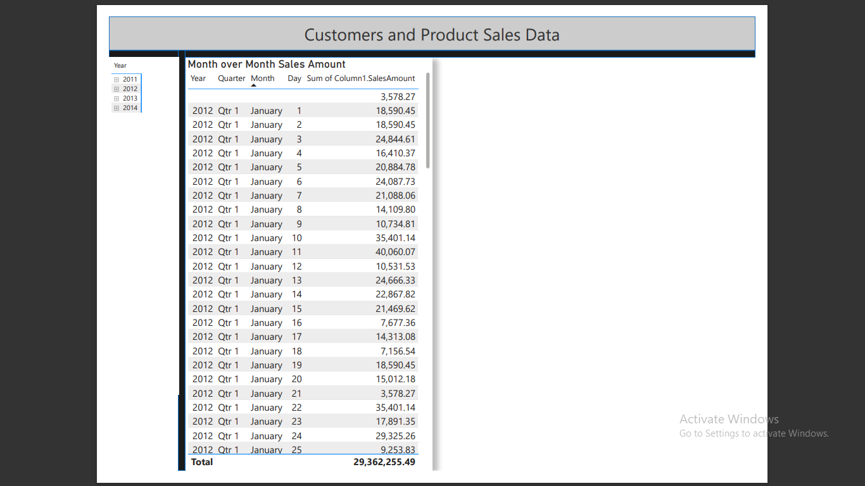

Slide 25
5. Derive Conclusion and Inferences from the Dashboard.
I converted JSON file into Excel file after that transferred into Power BI Dekstop.
2. I had to clean data where it has to be converted text into whole number in Data View first to calculate various majors as well.
3.Created TotalSalesAmount,Min,Max and Average measures using DAX(Data Analysis Expression)I used data type conversion and converted text into whole number value to calculate Total_Sales_Amount in Power BI Dekstop and found whole number at right side of the table initially text was appearing at left before conversion as well.
4.Implemented Minimum_Sales_Amount = Min('Product Sales'[Column1.SalesAmount]) of DAX Function. Maximum_Sales_Amount = Max('Product Sales'[Column1.SalesAmount]) of DAX Function.
5.Average_Sales_Amount = Average ('Product Sales'[Column1.SalesAmount]) of DAX Function.
6.Elaborated Data filters to calculate Highest, Minimum, Maximum and Average Sales amount of the customers.
7.I had to remove null value to highlight highest sales amount of the customers and used Tableau to filter
parameters related the given JSON file.

